Slide 1

Counting in loops
Pivot or critical instruction
The instruction that corresponds to asymptotically largest function.
If $I_{1}$executes $\frac{n(n−1)}{2}$ times and $I_{2}$ executes 2n times then $I_{1}$is critical
If $I_{1}$executes $\frac{n(n−1)}{2}$times and $I_{2}$executes 2n times and $I_{3}$ executes $n^{2}$ times then $I_{3}$ is critical (because it has largest coefficient when compared to $I_{1}$)

Slide 2
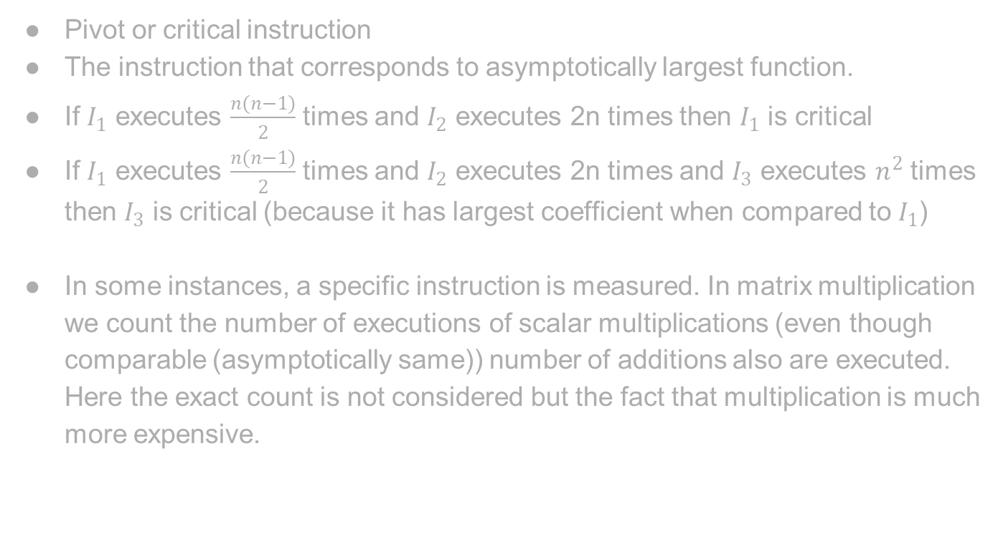
Counting in loops
Pivot or critical instruction
The instruction that corresponds to asymptotically largest function.
If $I_{1}$ executes $\frac{n(n−1)}{2}$ times and $I_{2}$ executes 2n times then $I_{1}$ is critical
If $I_{1}$ executes $\frac{n(n−1)}{2}$ times and $I_{2}$ executes 2n times and $I_{3}$ executes $n^{2}$ times then $I_{3}$ is critical (because it has largest coefficient when compared to $I_{1}$)
In some instances, a specific instruction is measured. In matrix multiplication we count the number of executions of scalar multiplications (even though comparable (asymptotically same)) number of additions also are executed. Here the exact count is not considered but the fact that multiplication is much more expensive.

Slide 3
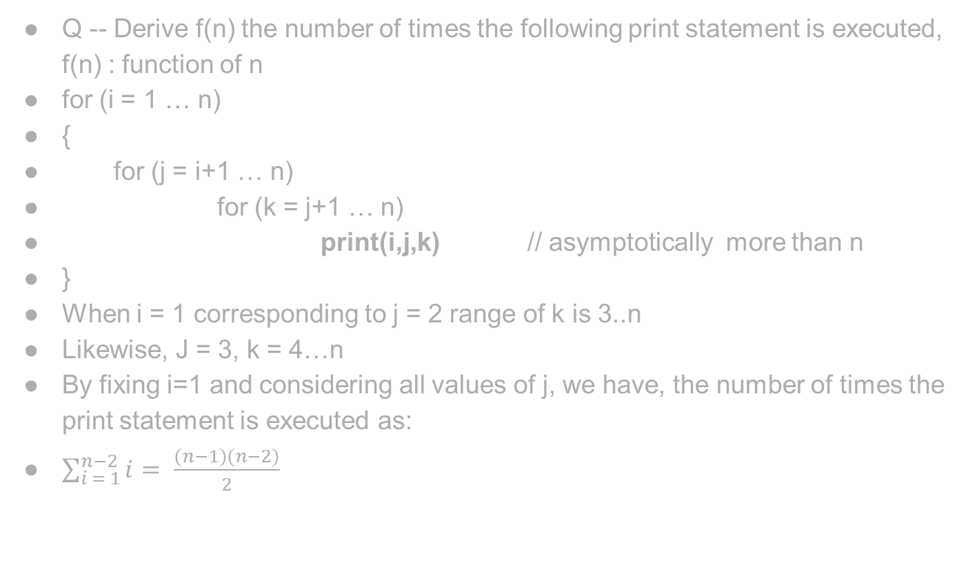
Counting in loops
Q -- Derive f(n) the number of times the following print statement is executed, f(n) : function of n
for (i = 1 … n)
{
for (j = i+1 … n)
for (k = j+1 … n)
print(i,j,k) // asymptotically more than n
}
When i = 1 corresponding to j = 2 range of k is 3..n
Likewise, J = 3, k = 4…n
By fixing i=1 and considering all values of j, we have, the number of times the print statement is executed as:
$\sum_{i = 1}^{n−2}{i}= \frac{(n−1)(n−2)}{2}$

Slide 4
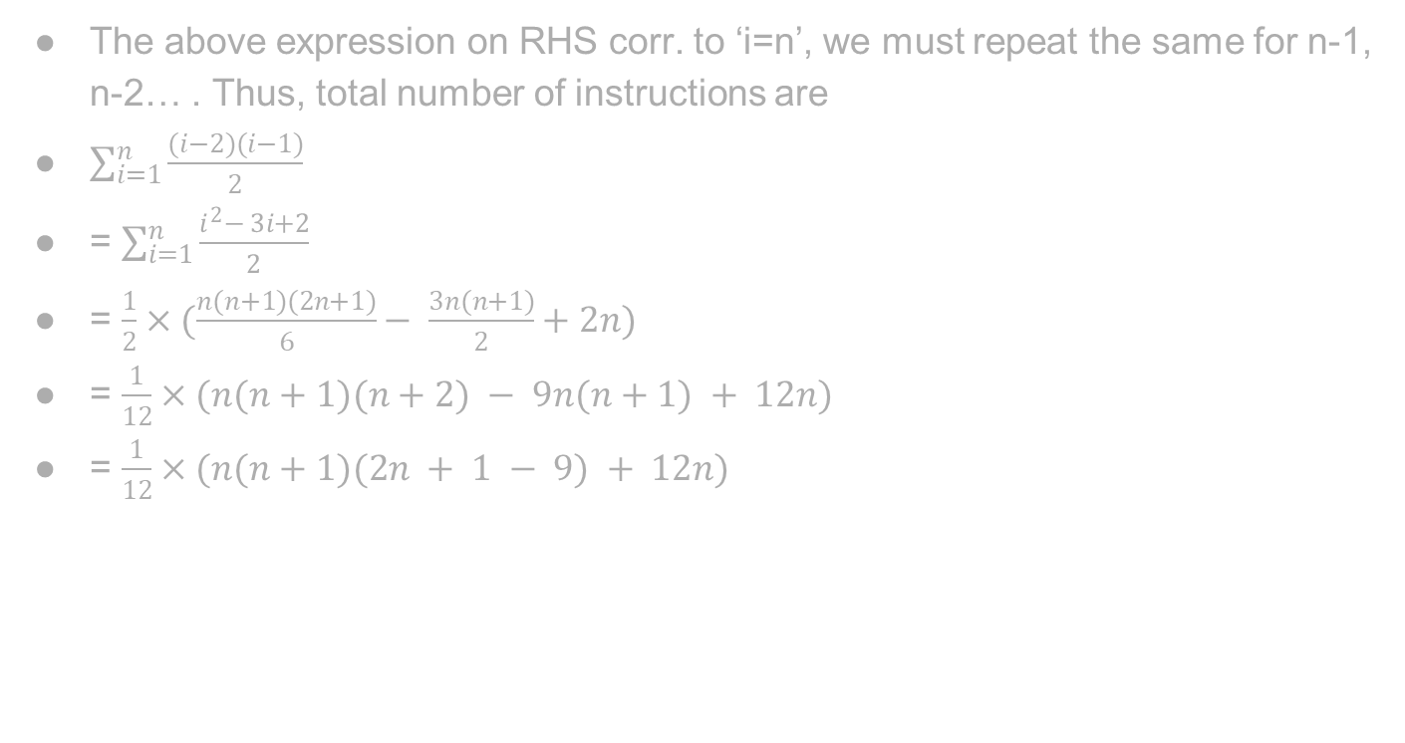
Counting in loops
The above expression on RHS corr. to ‘i=n’, we must repeat the same for n-1, n-2… . Thus, total number of instructions are
$\sum_{i=1}^{n}{\frac{(i−2)(i−1)}{2}}$
= $\sum_{i=1}^{n}{\frac{i^{2}− 3i+2}{2}}$
= $\frac{1}{2}×(\frac{n(n+1)(2n+1)}{6}− \frac{3n(n+1)}{2}+2n)$
= $\frac{1}{12}×(n(n+1)(n+2) − 9n(n+1) + 12n)$
= $\frac{1}{12}×(n(n+1)(2n + 1 − 9) + 12n)$

Slide 5

Counting in loops
= $\frac{1}{12}×(n(n+1)(2n − 8) + 12n)$
= $\frac{2}{12}×(n(n+1)(n − 4) + 6n)$
= $\frac{1}{6}×n × ((n+1)(n − 4) + 6)$
= $\frac{1}{6}×n × (n^{2} + 2 − 3n)$
= $\frac{1}{6}×n × (n−1) ×(n−2)$

